Slide 1
Contact Management System
Created By-
Name – Sharad Pratap singh
Class – mca(general)
Uid – 24mca20380
Section – 6(a)
Subject – python lab
Subject code – 24cah-606

Slide 2
Abstract
A Contact Management System (CMS) is an essential tool for individuals and organizations to efficiently manage their contact information.This system provides a centralized database to store, organize, and retrieve contact details, including names, phone numbers, address, and gender. It streamlines communication and supports relationshipsbuilding efforts by offering features such as search and filter capabilities, group , and integration with contactingplatforms. The CMS aims to improve productivity and ensure that vital contact information is easily accessible, uptodate, and secure, ultimately fostering better connections and informed decision-making.

Slide 3
Introduction
The Contact Management System is a Python-based application designed to manage and organize a list of contacts efficiently. This project helps users store, update, and delete contact details like name, address, gender, and phone number, all within a simple GUI created using the Tkinter module. The system’s primary purpose is to allow users to store personal information and maintain an organized contact list, which can be modified as needed.
This project is a great way to demonstrate how Python can be used to build functional GUI applications. It’s also an excellent learning tool for beginners to improve their skills in Python programming, especially in creating GUI-based applications using Tkinter.

Slide 4
Purpose
The purpose of creating a Contact Management System (CMS) is to streamline the process of organizing, storing, and accessing contact information efficiently. By centralizing contact details, such as names, phone numbers, age. Contact Management System enhances communication and collaboration.

Slide 5
Features of the Contact Management System:
View All Contacts: On launching the application, the user can view all stored contacts.
Add Contacts: Users can add new contacts by filling out the form with relevant details.
Update Contacts: The system allows users to modify existing contact details by double-clicking on a particular entry.
Delete Contacts: Users can remove any contact from the list by selecting it and clicking the delete button.

Slide 6
Required Modules or Packages:
The system was developed using Tkinter, which is a Python package used for building simple GUI applications. Below are the essential packages required for this project:
Tkinter:
Used for building the graphical user interface (GUI).
Provides various widgets such as buttons, text fields, and tables, which are essential for creating the contact management system.
Installation: pip install tk

Slide 7
SQLite3:
Used for managing the database that stores all the contact details.
SQLite is a lightweight, file-based database that requires minimal configuration and works well for small applications.
No external installation is required for SQLite, as it comes bundled with Python.
Database Connection:
The project uses SQLite3 to handle database operations, ensuring efficient management of contact information.

Slide 8
CODING

Slide 9
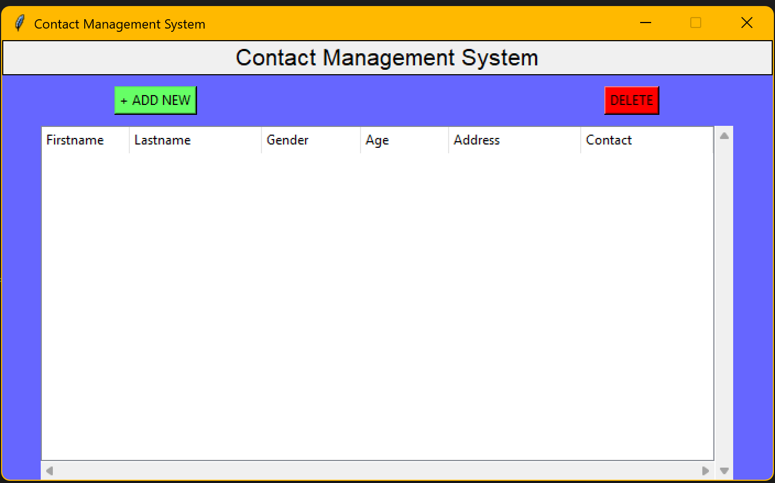
When I run the code

Slide 10
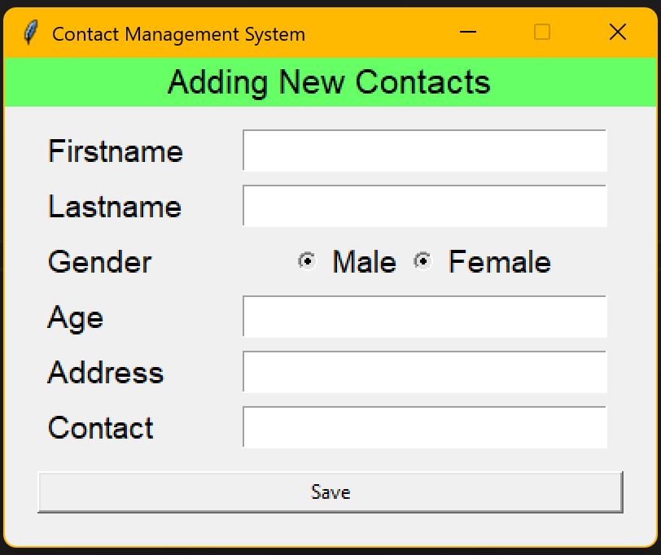
When I click on add new

Slide 11
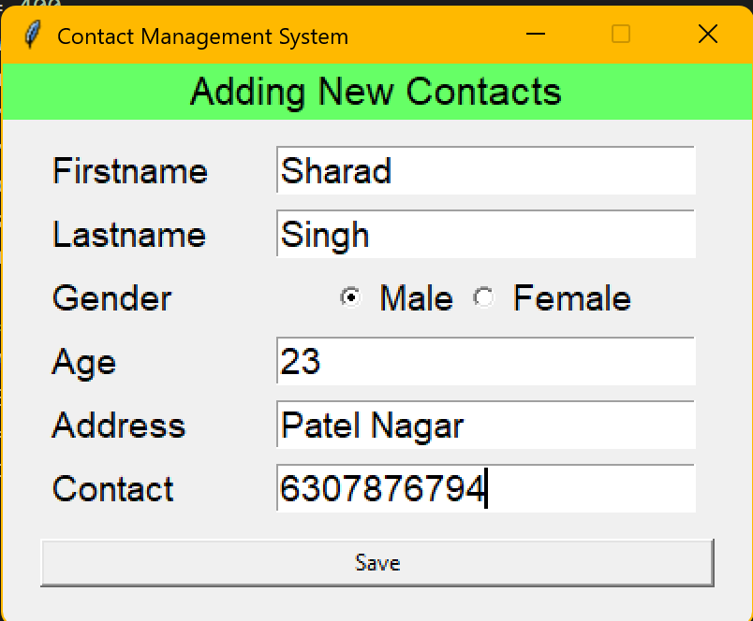
When I fill all the section

Slide 12
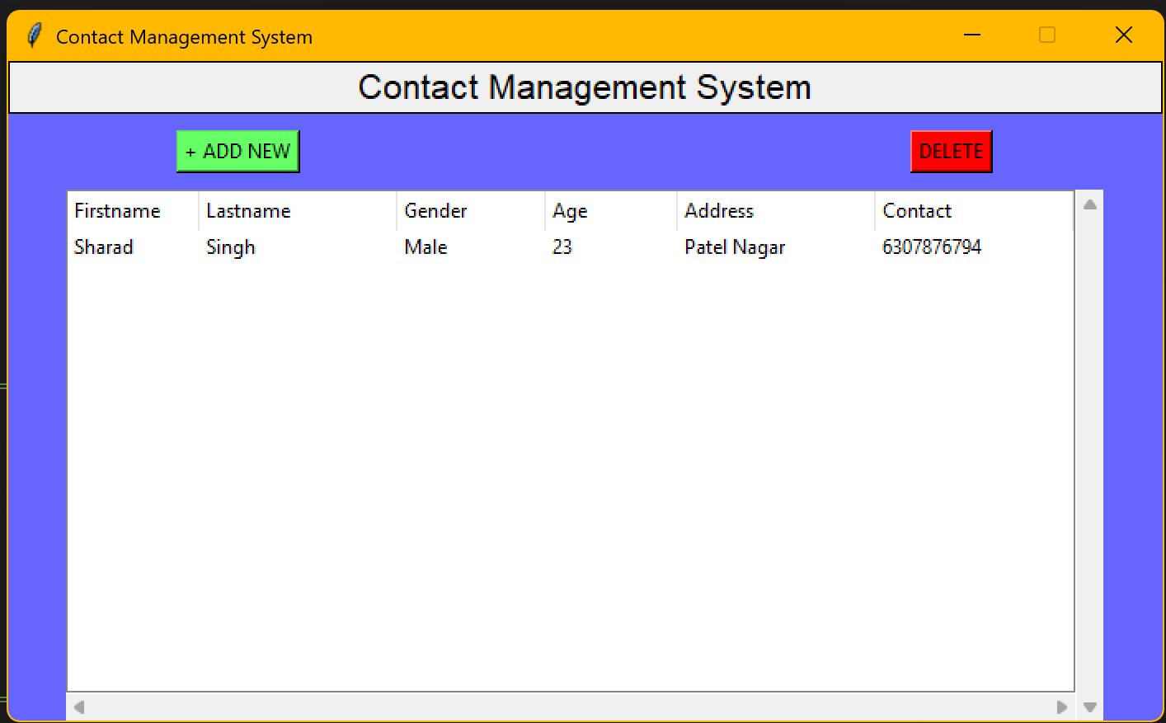
When I click on save button

Slide 13
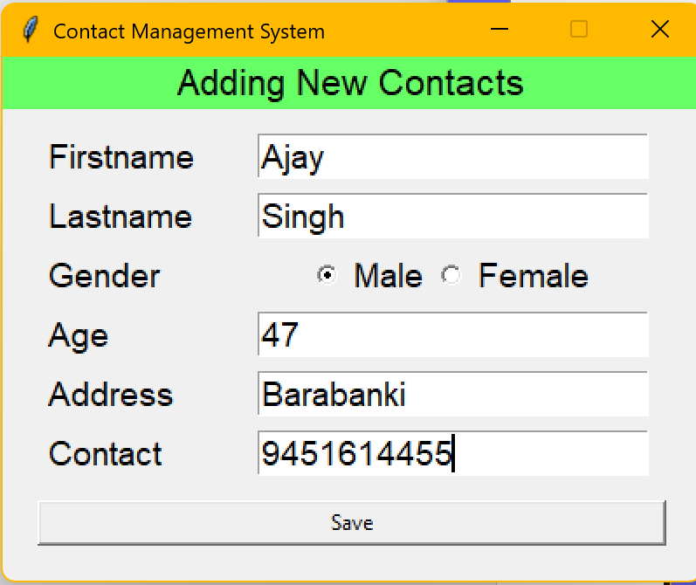
Add one more contact

Slide 14
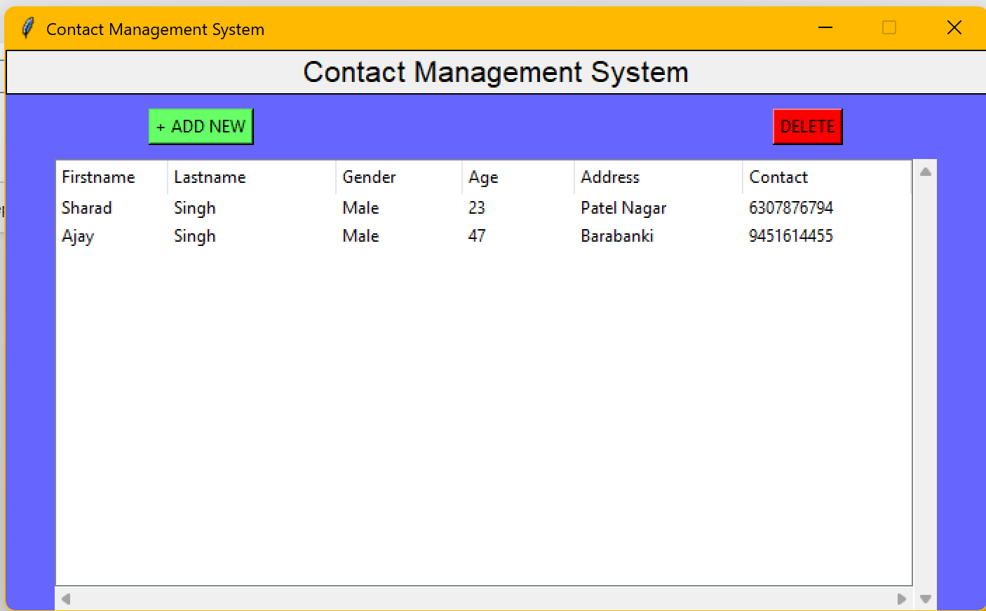
After two entries

Slide 15
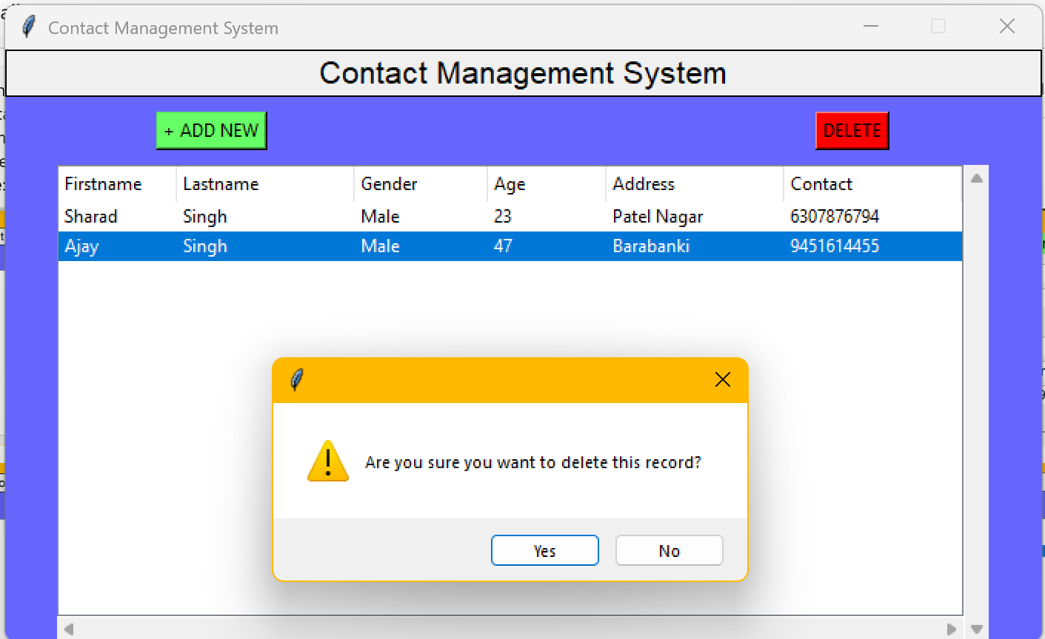
Delete one contact from the system

Slide 16
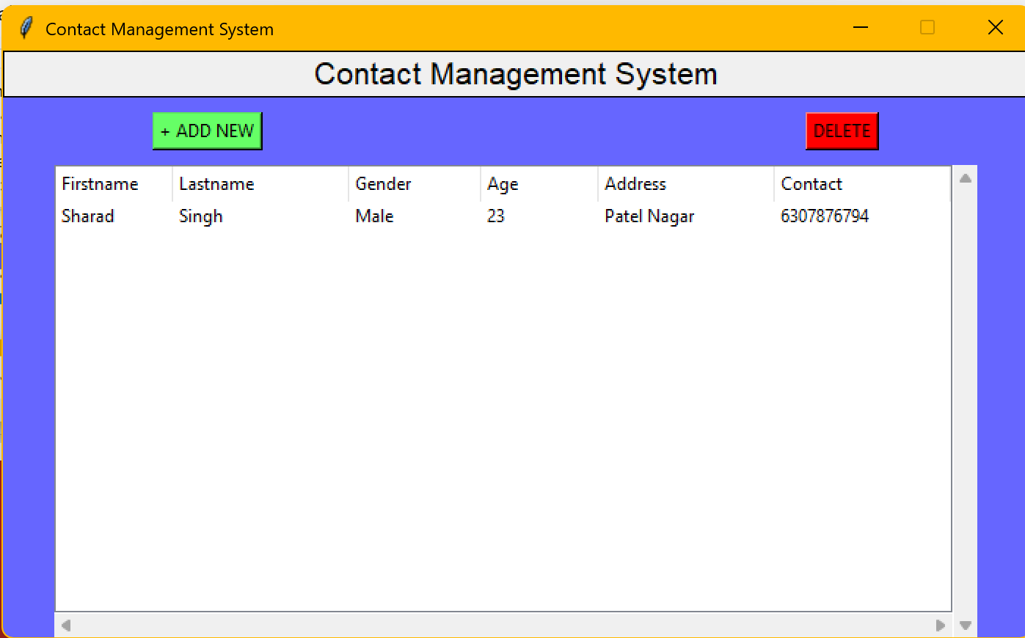
After deleting the user

Slide 17
Conclusion
In conclusion, a Contact Management System (CMS) is a vital tool for organizing and maintaining essential contact information. By centralizing data, it simplifies the management of contact, enhancing communication and collaboration. With features like efficient ,member’s other detail , a CMS boosts productivity and ensures that critical information is easily accessible. Ultimately, a well-designed CMS fosters better connections

Slide 18
Refrence
ZOHO - Best Contact Management Software - Zoho CRM
CRM Organisation - Best Contact Management Software: Top 16 Systems & Databases | CRM.org
Zendesk - Top 10 Contact Management Software Platforms | Tools for 2024
SCRIBD - Contact Management System | PDF | Databases | Software Testing

